Slide 1
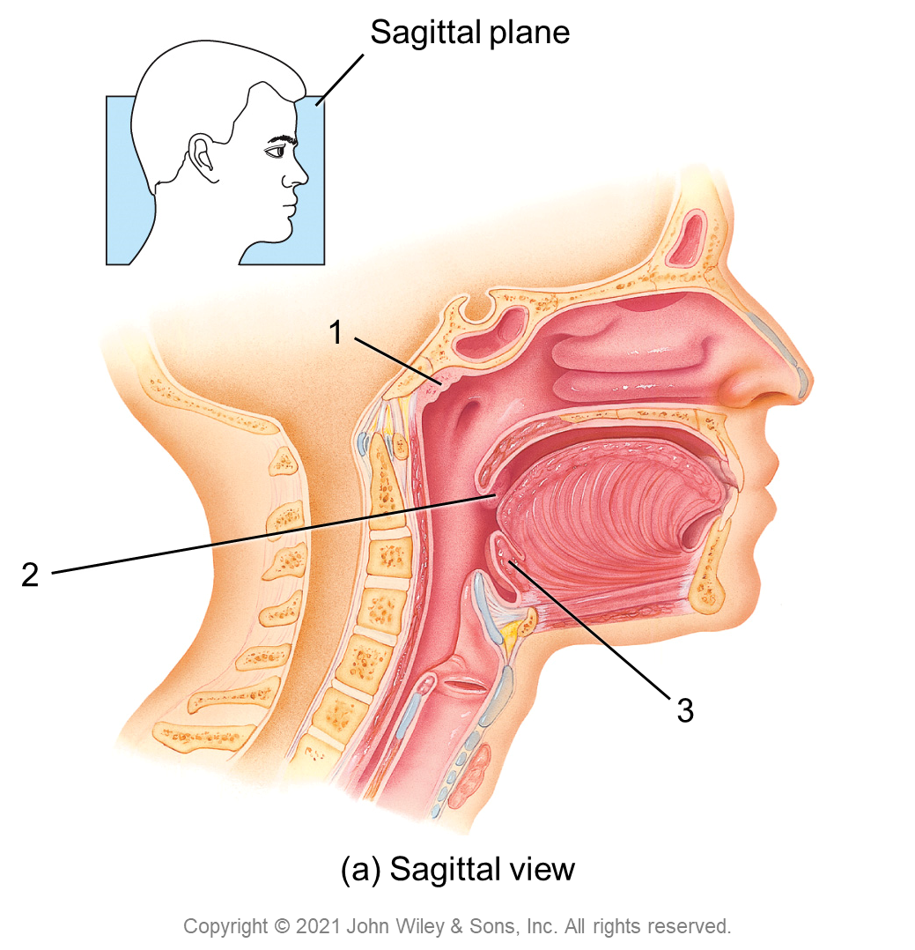
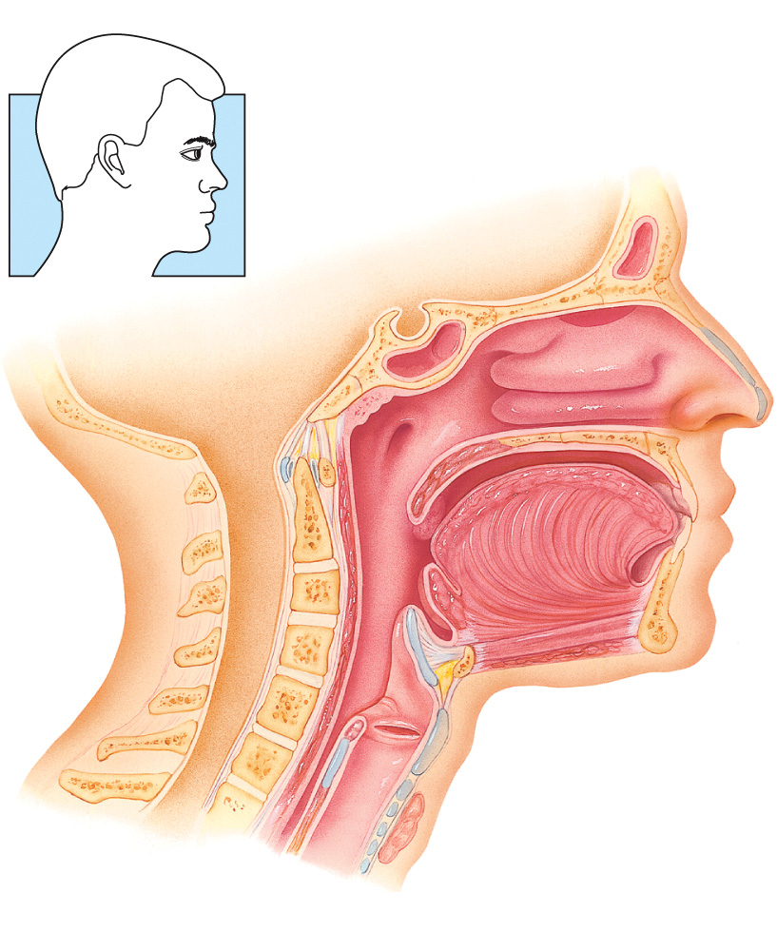
Sagittal plane
1
2
3
(a) Sagittal view
Copyright © 2021 John Wiley & Sons, Inc. All rights reserved.

Slide 2
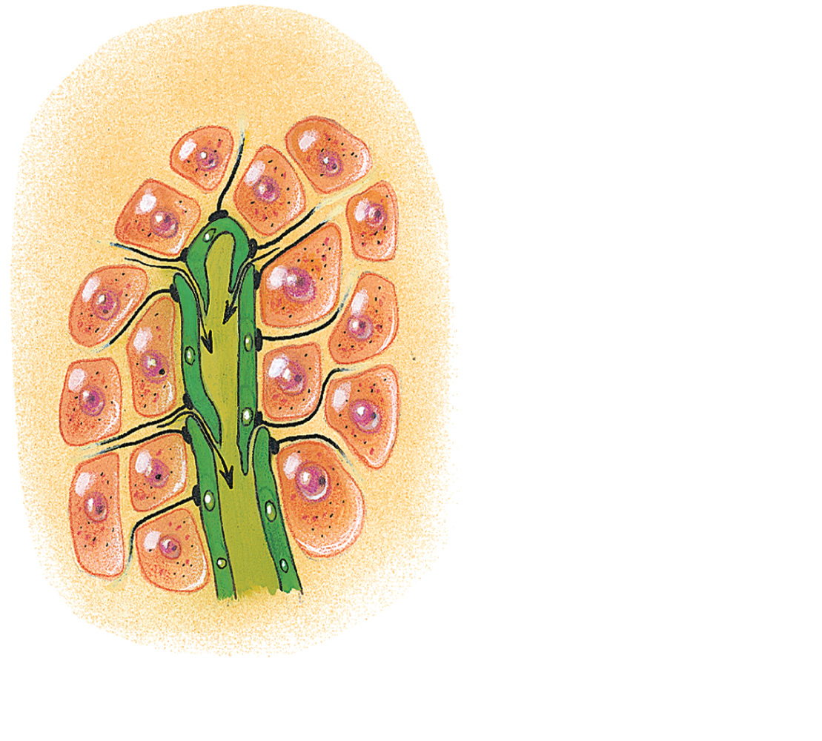
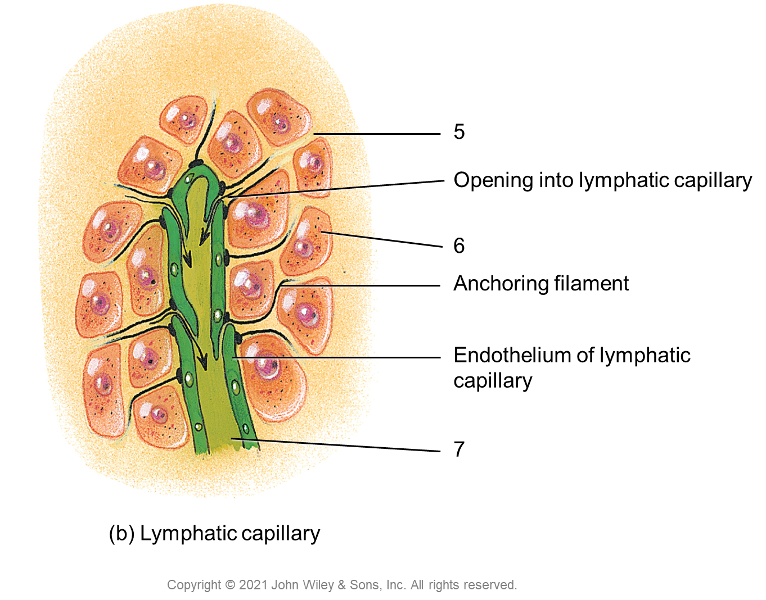
5
Opening into lymphatic capillary
6
Anchoring filament
Endothelium of lymphatic capillary
7
(b) Lymphatic capillary
Copyright © 2021 John Wiley & Sons, Inc. All rights reserved.

Slide 3
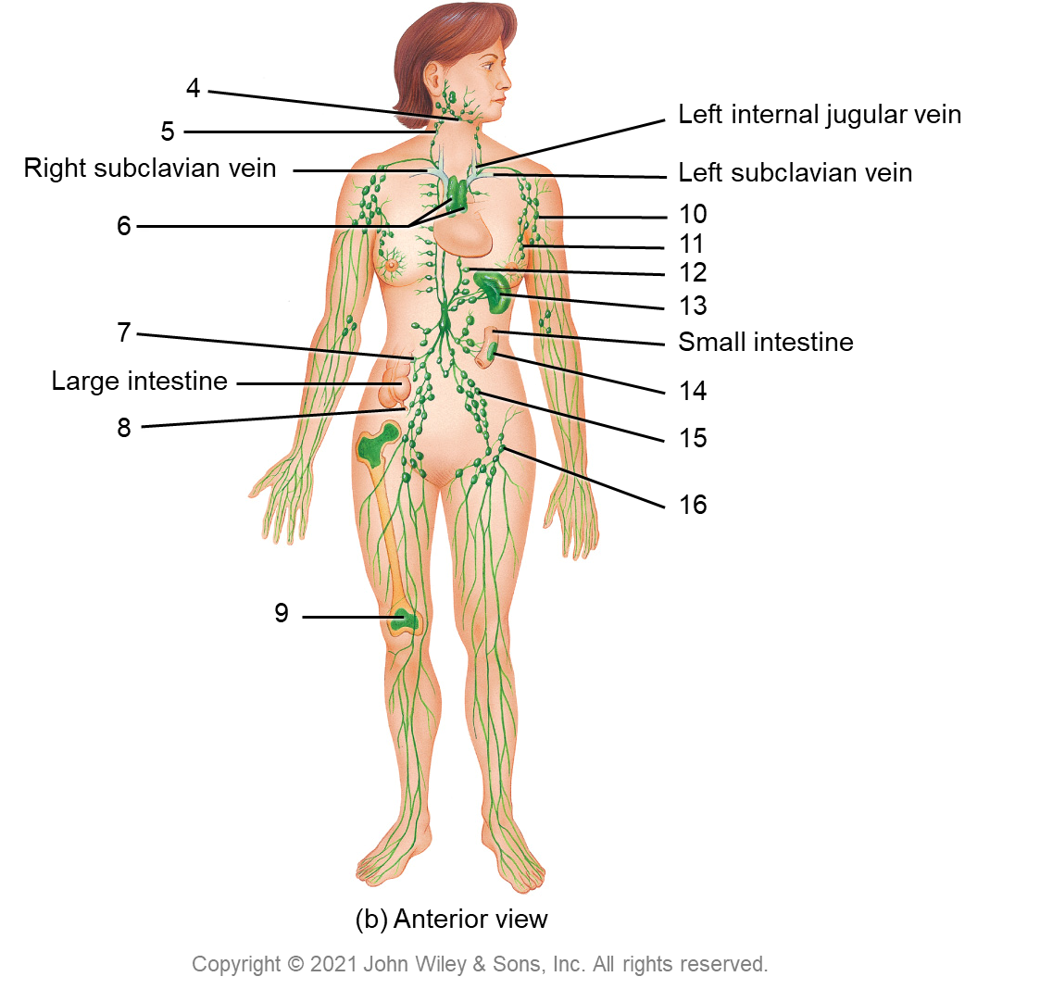
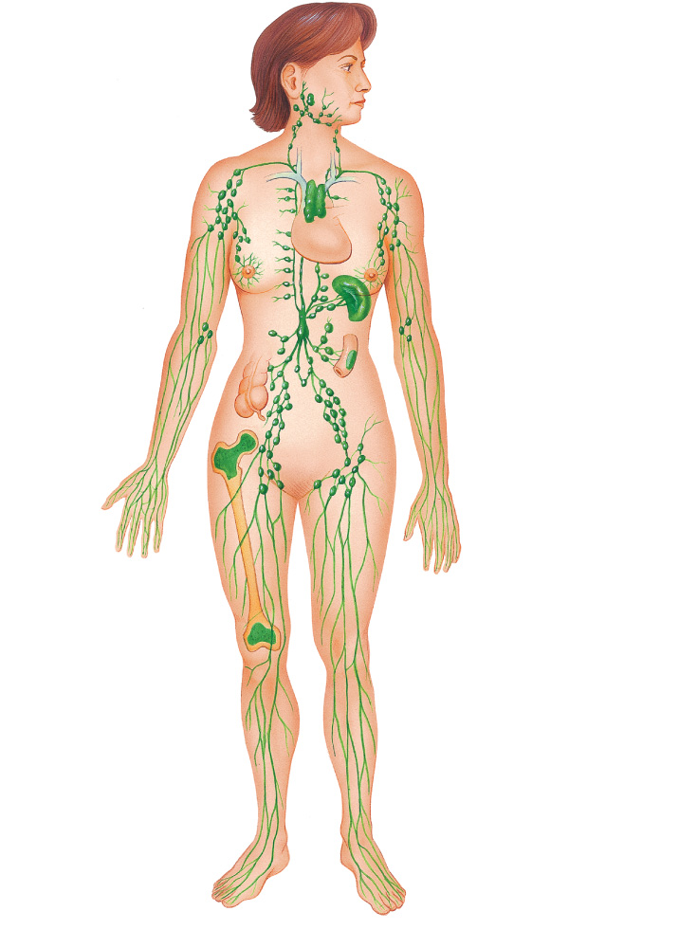
4
5
Left internal jugular vein
Right subclavian vein
Left subclavian vein
6
10
11
12
13
7
Small intestine
Large intestine
14
8
15
16
9
(b) Anterior view
Copyright © 2021 John Wiley & Sons, Inc. All rights reserved.

Slide 4
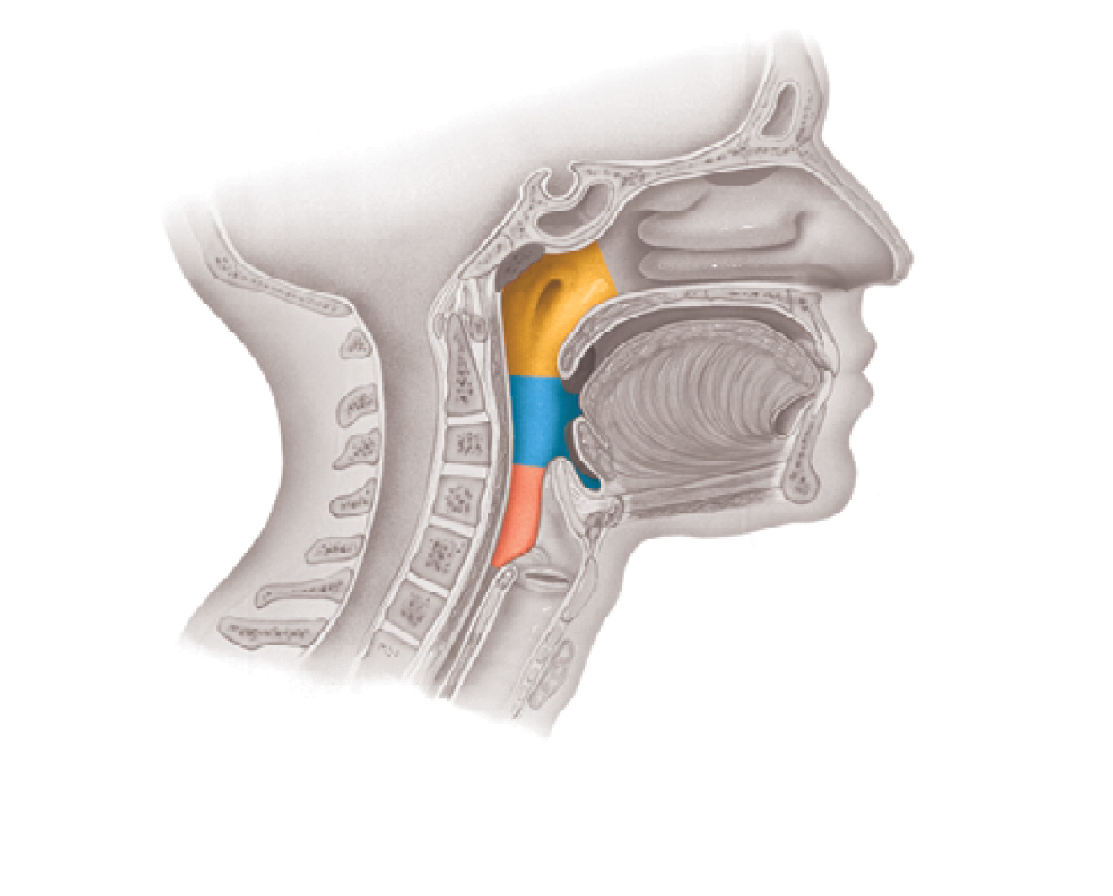
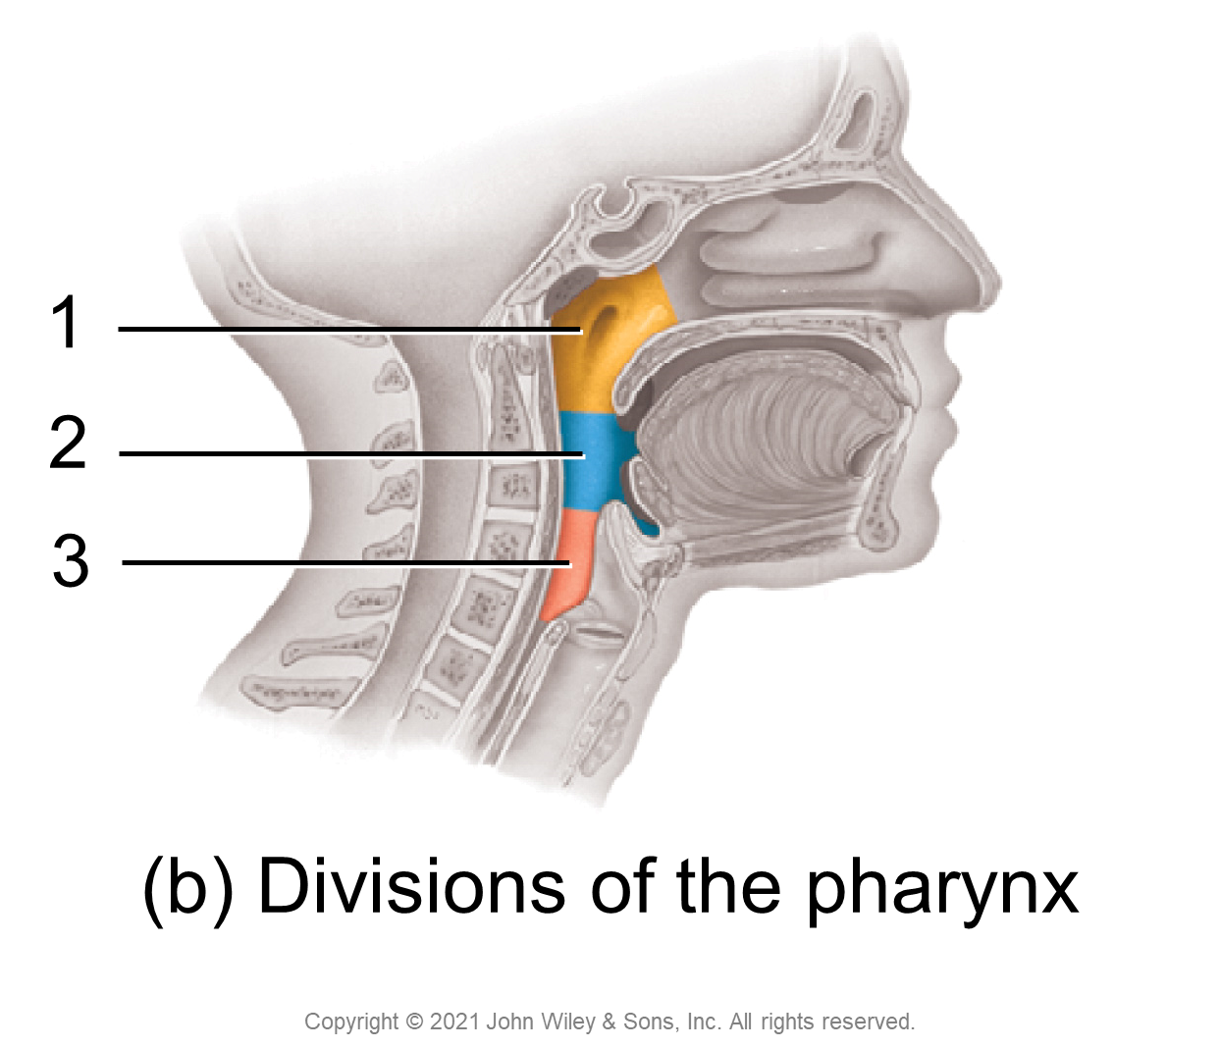
1
2
3
(b) Divisions of the pharynx
Copyright © 2021 John Wiley & Sons, Inc. All rights reserved.

Slide 5
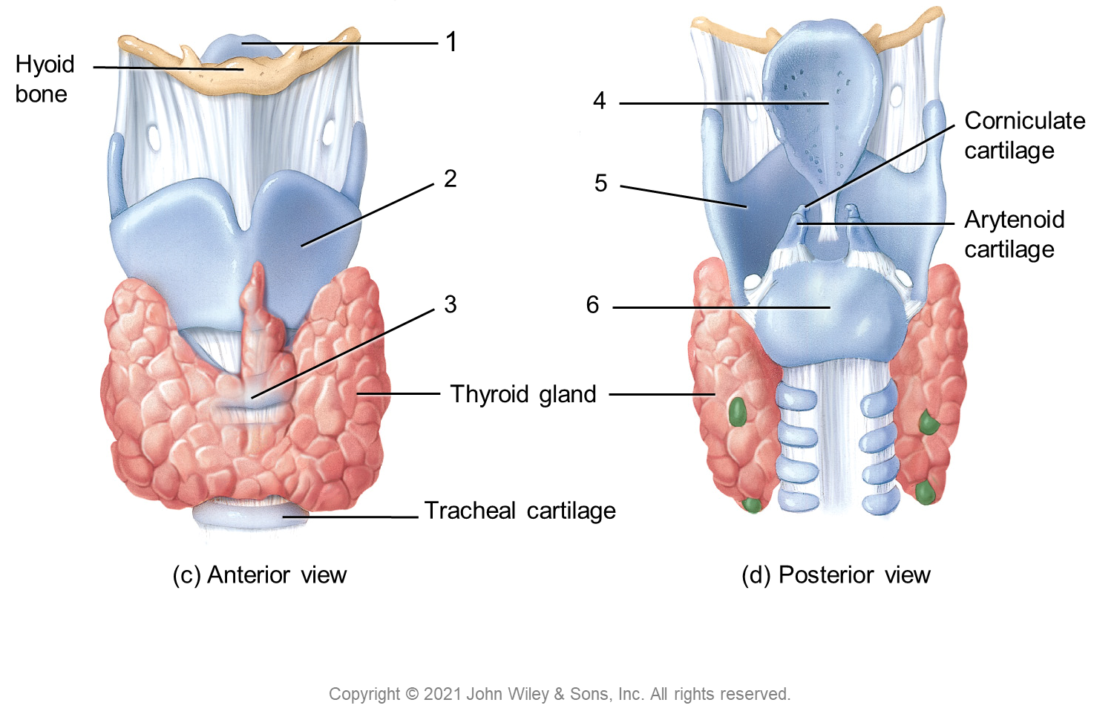
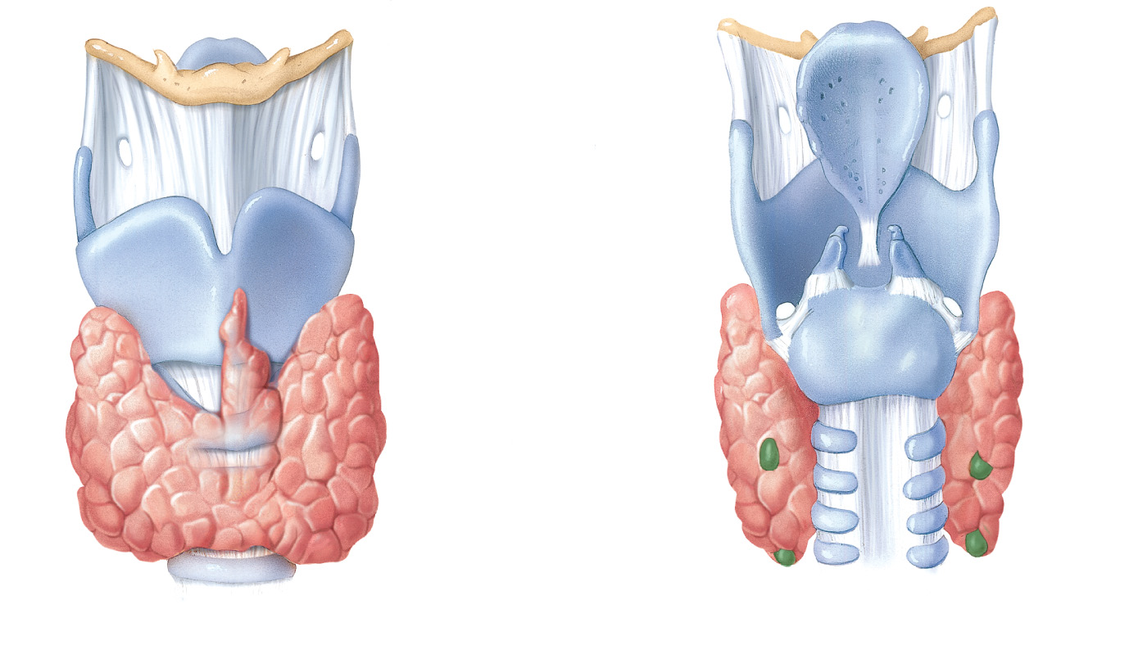
1
Hyoid bone
4
Corniculate
cartilage
2
5
Arytenoid
cartilage
3
6
Thyroid gland
Tracheal cartilage
(c) Anterior view
(d) Posterior view
Copyright © 2021 John Wiley & Sons, Inc. All rights reserved.

Slide 6
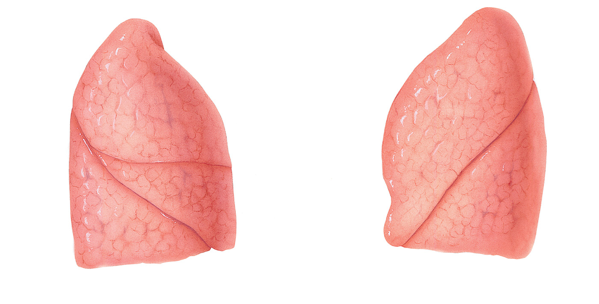
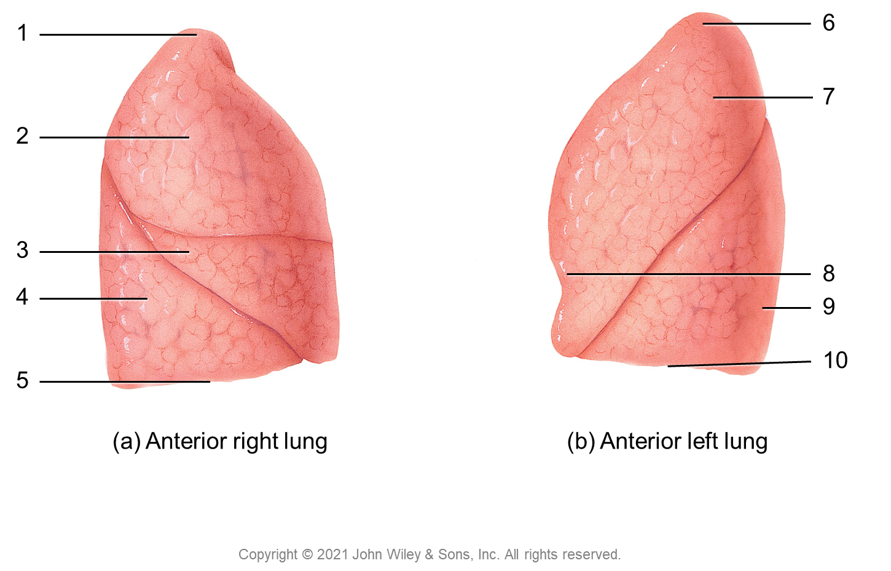
1
6
7
2
3
8
4
9
10
5
(a) Anterior right lung
(b) Anterior left lung
Copyright © 2021 John Wiley & Sons, Inc. All rights reserved.

Slide 7
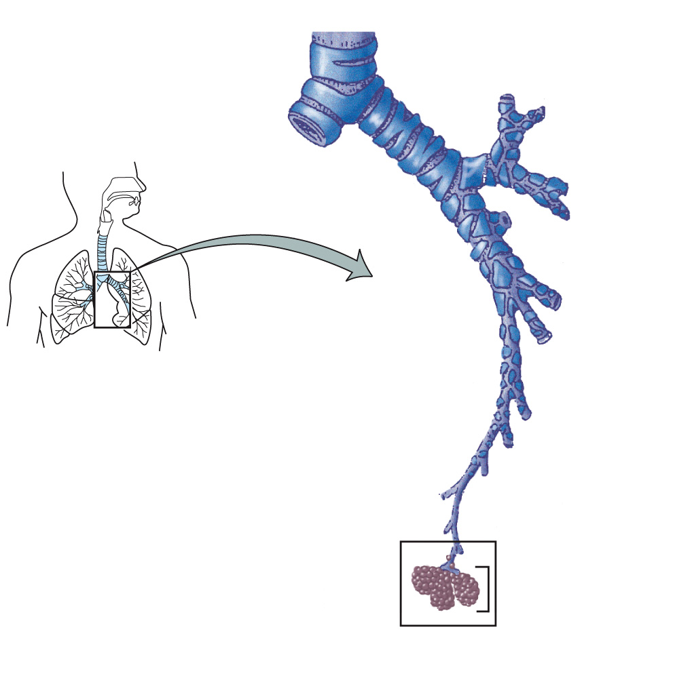
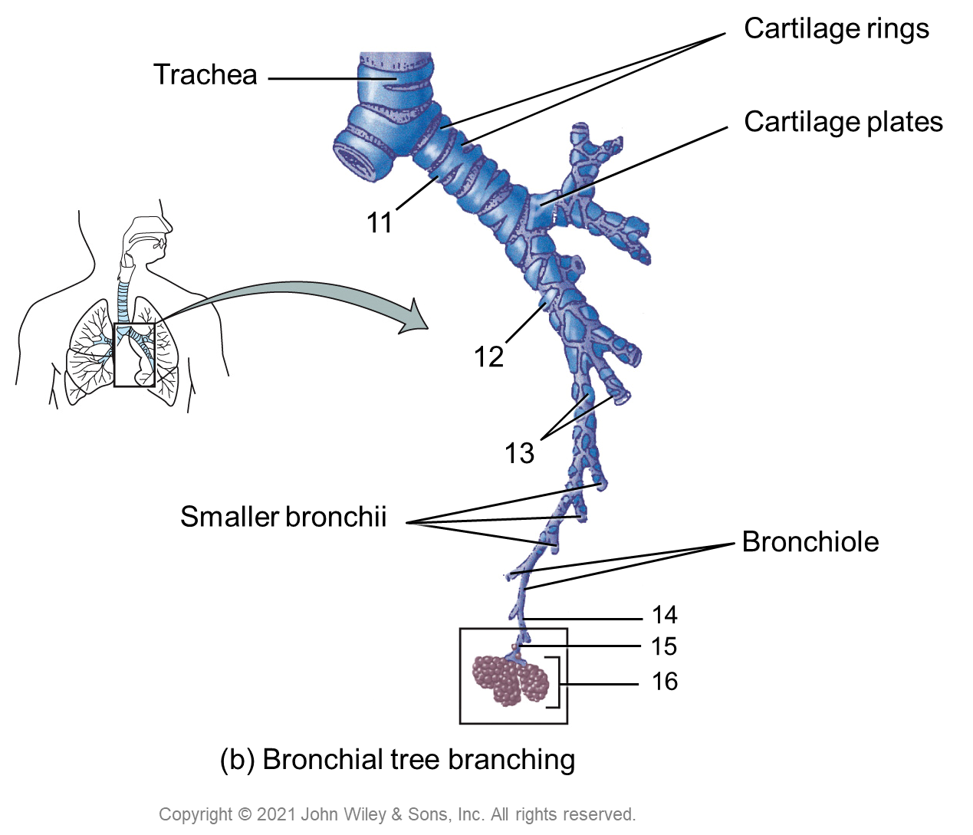
Cartilage rings
Trachea
Cartilage plates
11
12
13
Smaller bronchii
Bronchiole
14
15
16
(b) Bronchial tree branching
Copyright © 2021 John Wiley & Sons, Inc. All rights reserved.

Slide 8
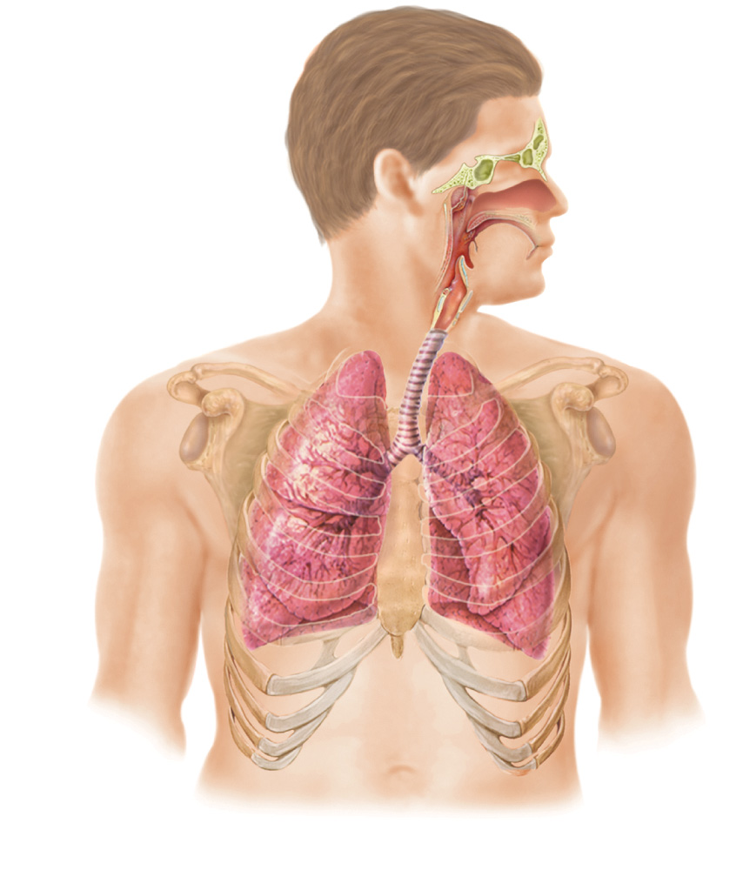
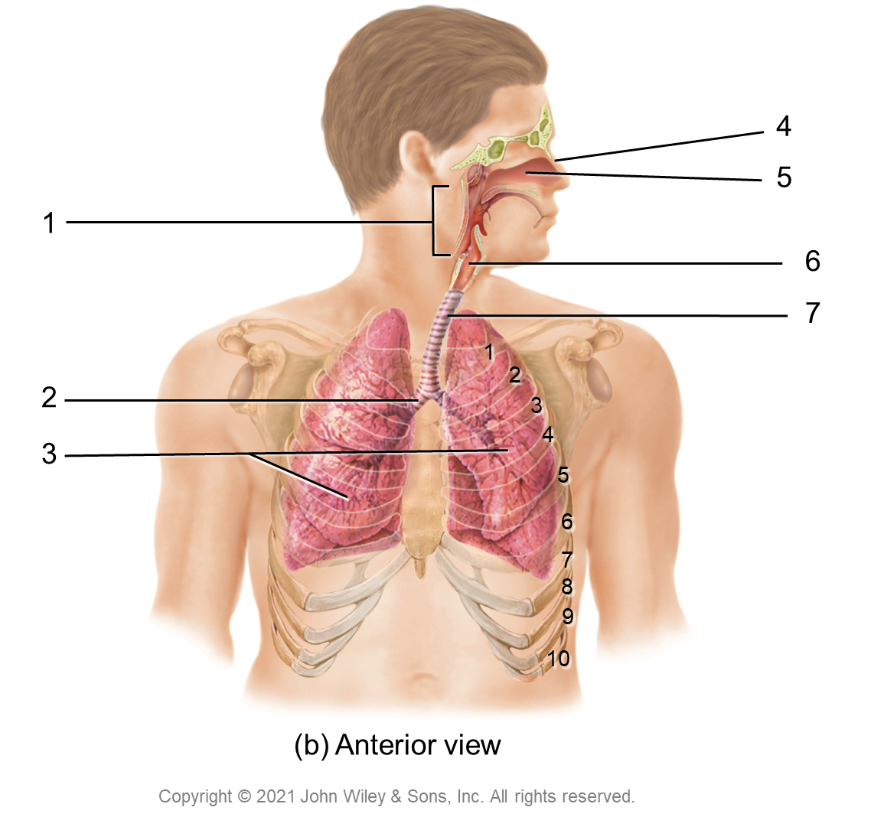
4
5
1
6
7
1
2
2
3
3
4
5
6
7
8
9
10
(b) Anterior view
Copyright © 2021 John Wiley & Sons, Inc. All rights reserved.

Slide 9
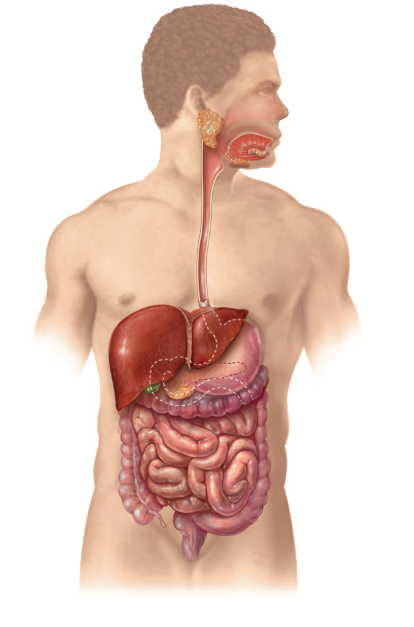
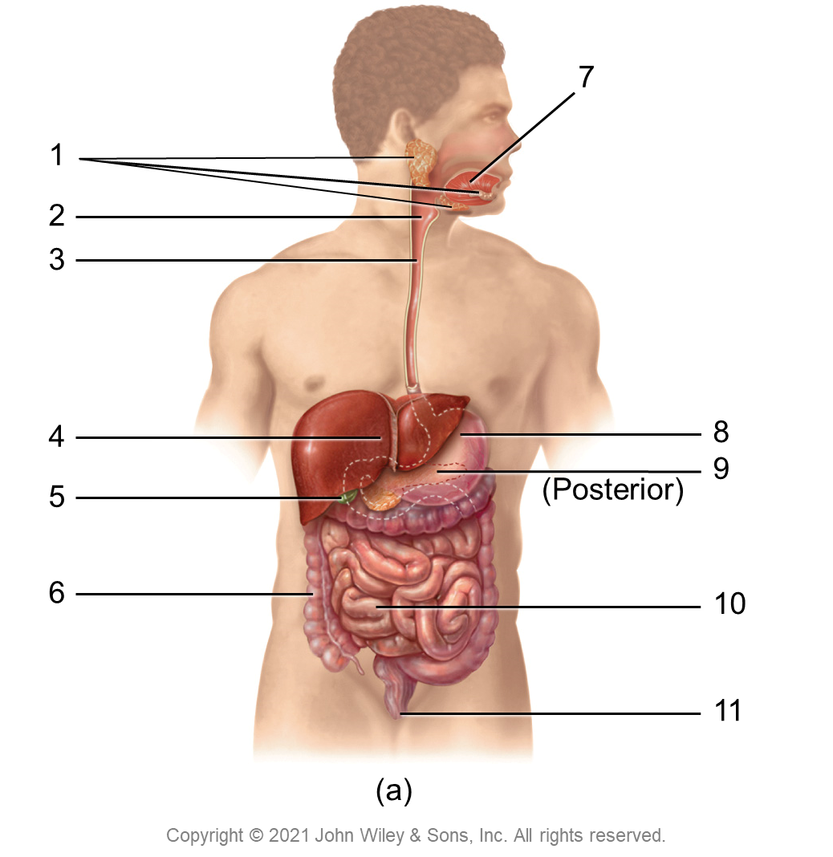
7
1
2
3
4
8
9
5
(Posterior)
6
10
11
(a)
Copyright © 2021 John Wiley & Sons, Inc. All rights reserved.

Slide 10
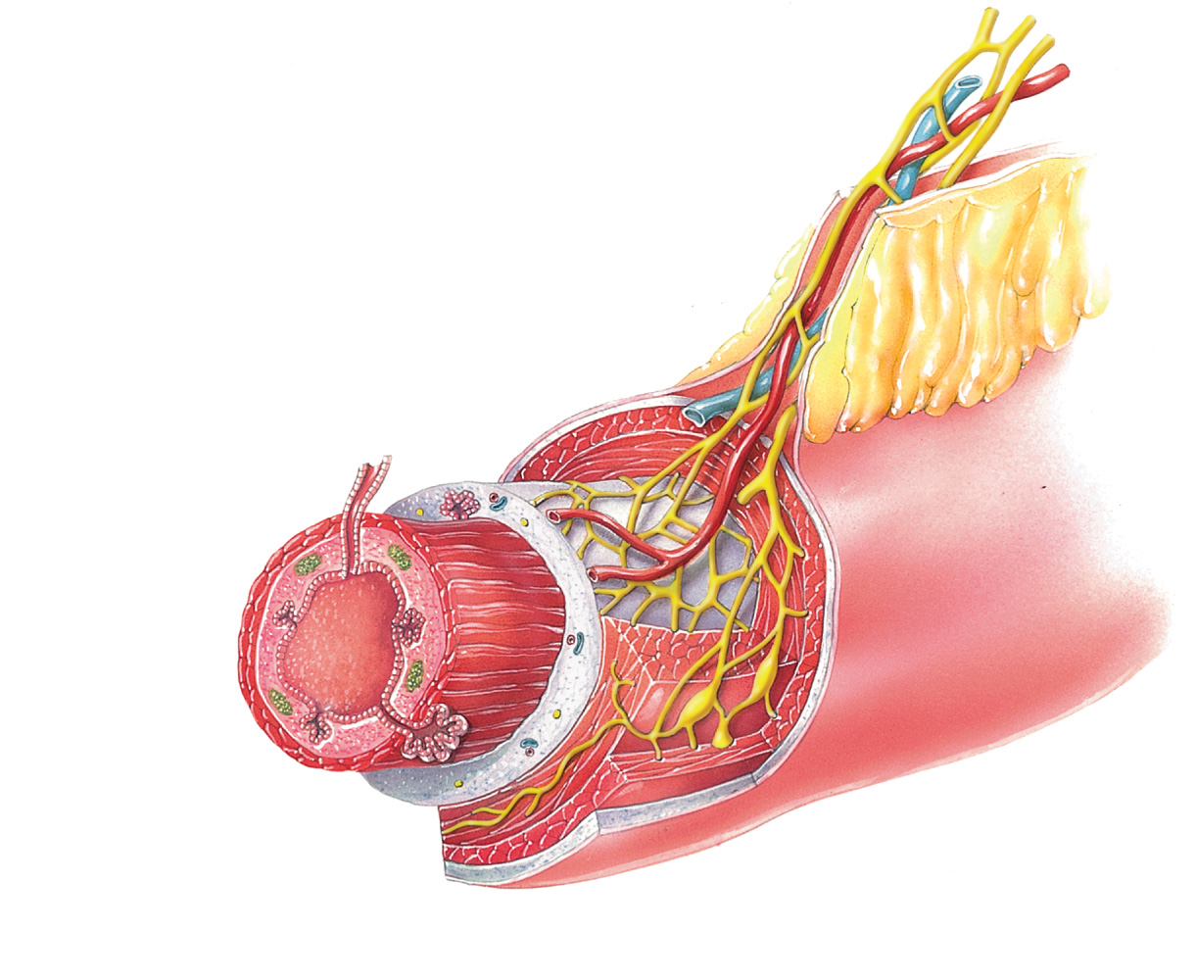
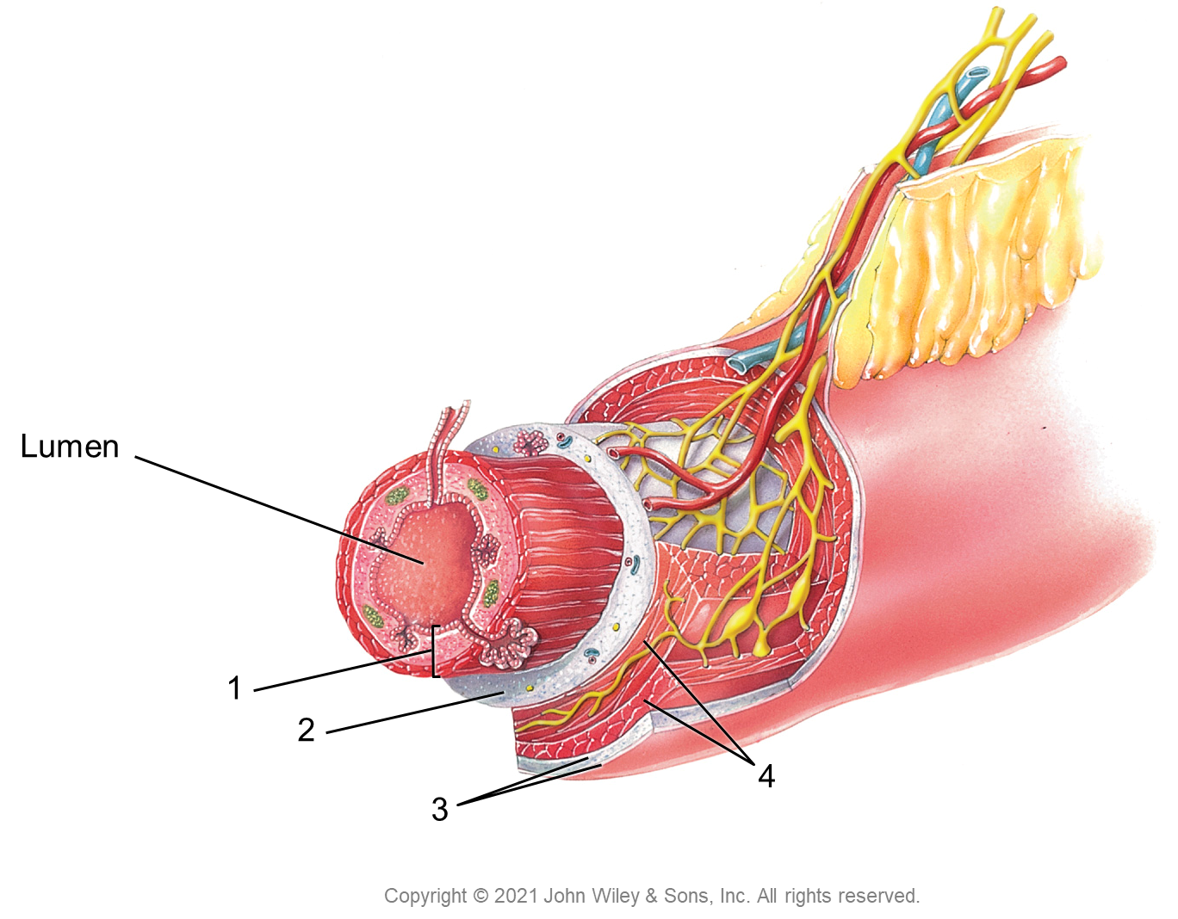
Lumen
1
2
4
3
Copyright © 2021 John Wiley & Sons, Inc. All rights reserved.

Slide 11
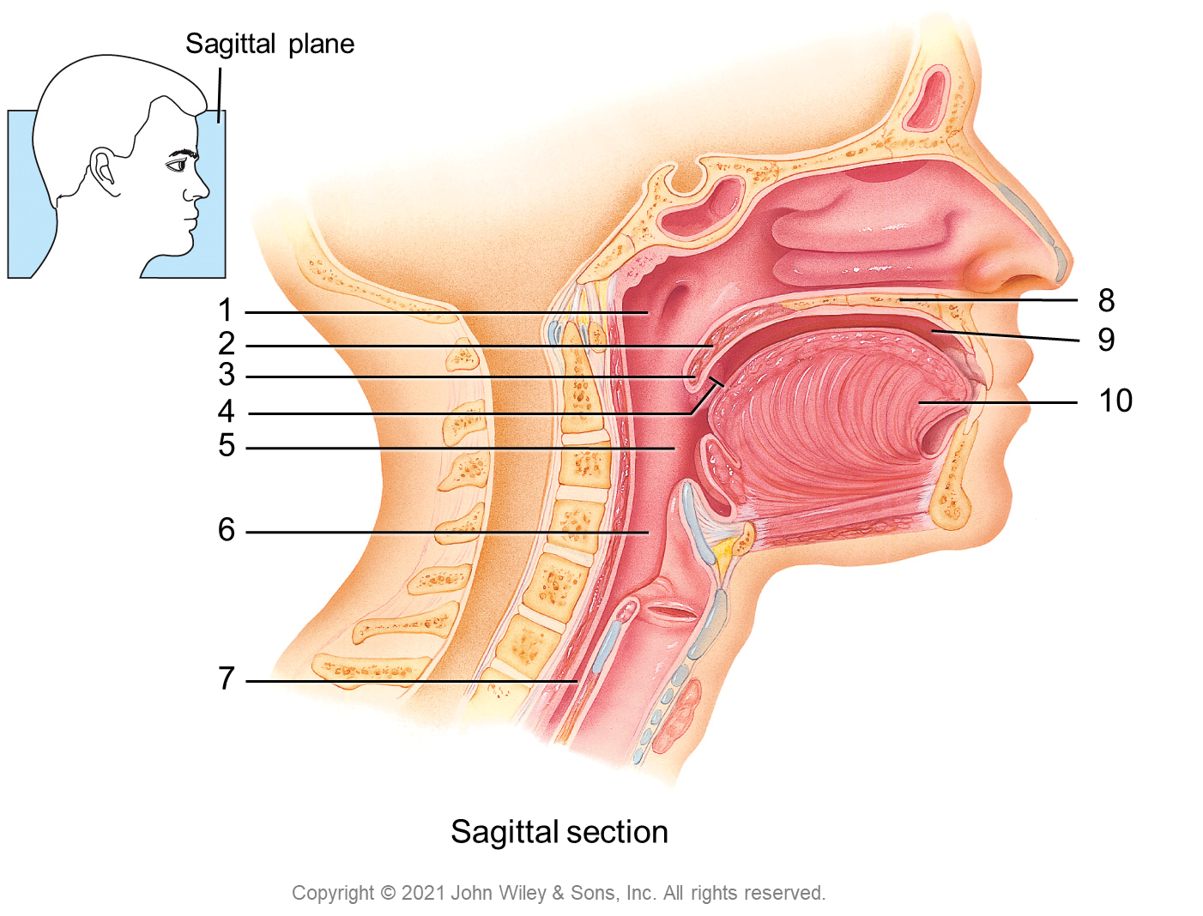
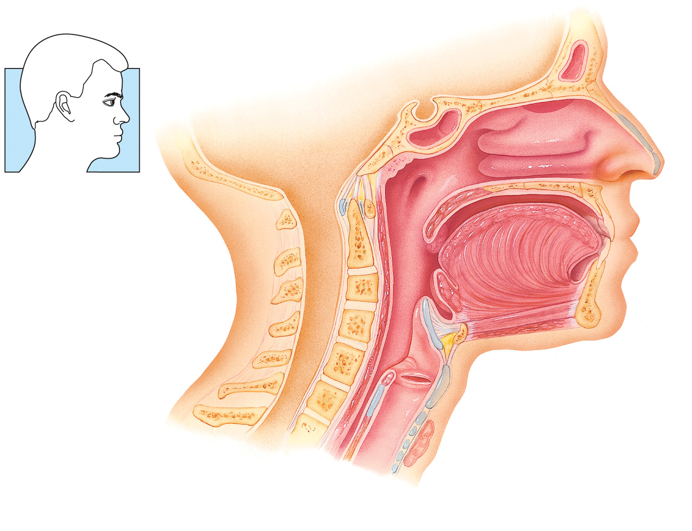
Sagittal plane
1
8
2
9
3
4
10
5
6
7
Sagittal section
Copyright © 2021 John Wiley & Sons, Inc. All rights reserved.

Slide 12
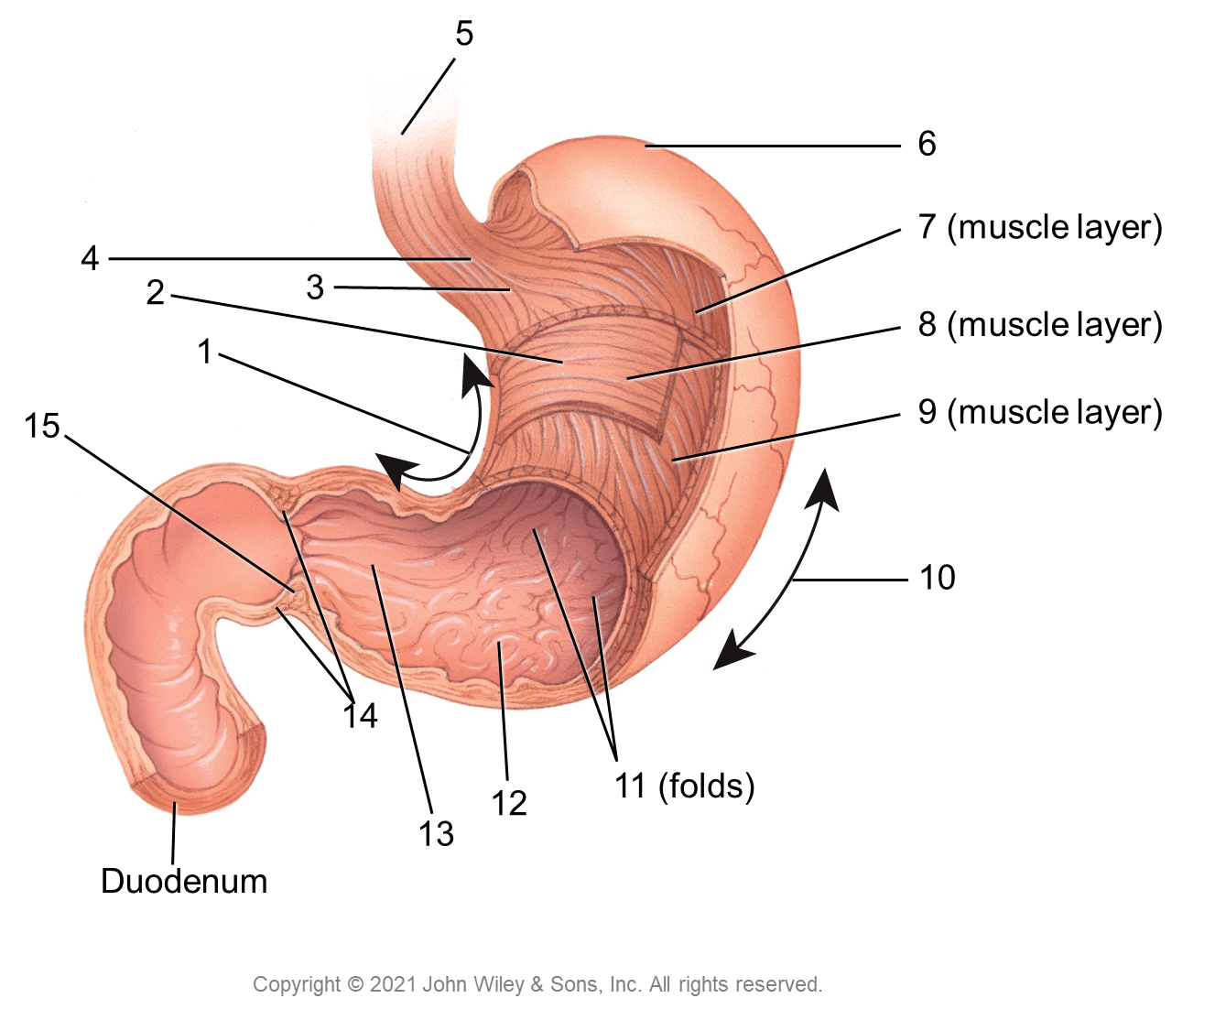
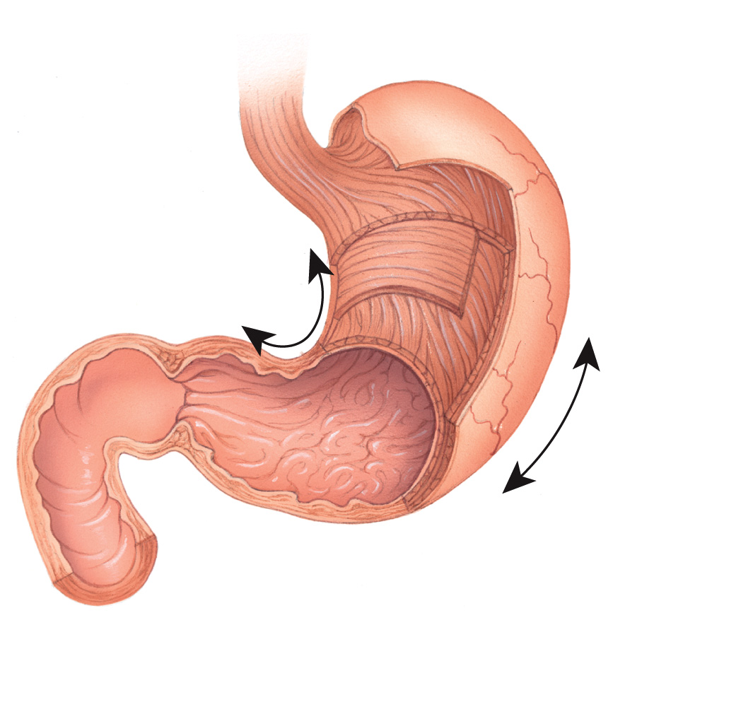
5
6
7 (muscle layer)
4
2
3
8 (muscle layer)
1
15
9 (muscle layer)
10
14
12
11 (folds)
13
Duodenum
Copyright © 2021 John Wiley & Sons, Inc. All rights reserved.

Slide 13
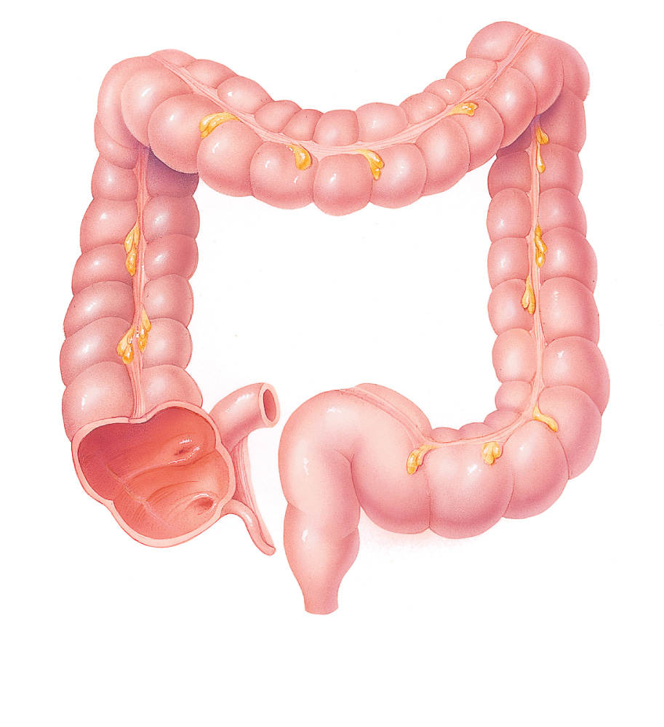
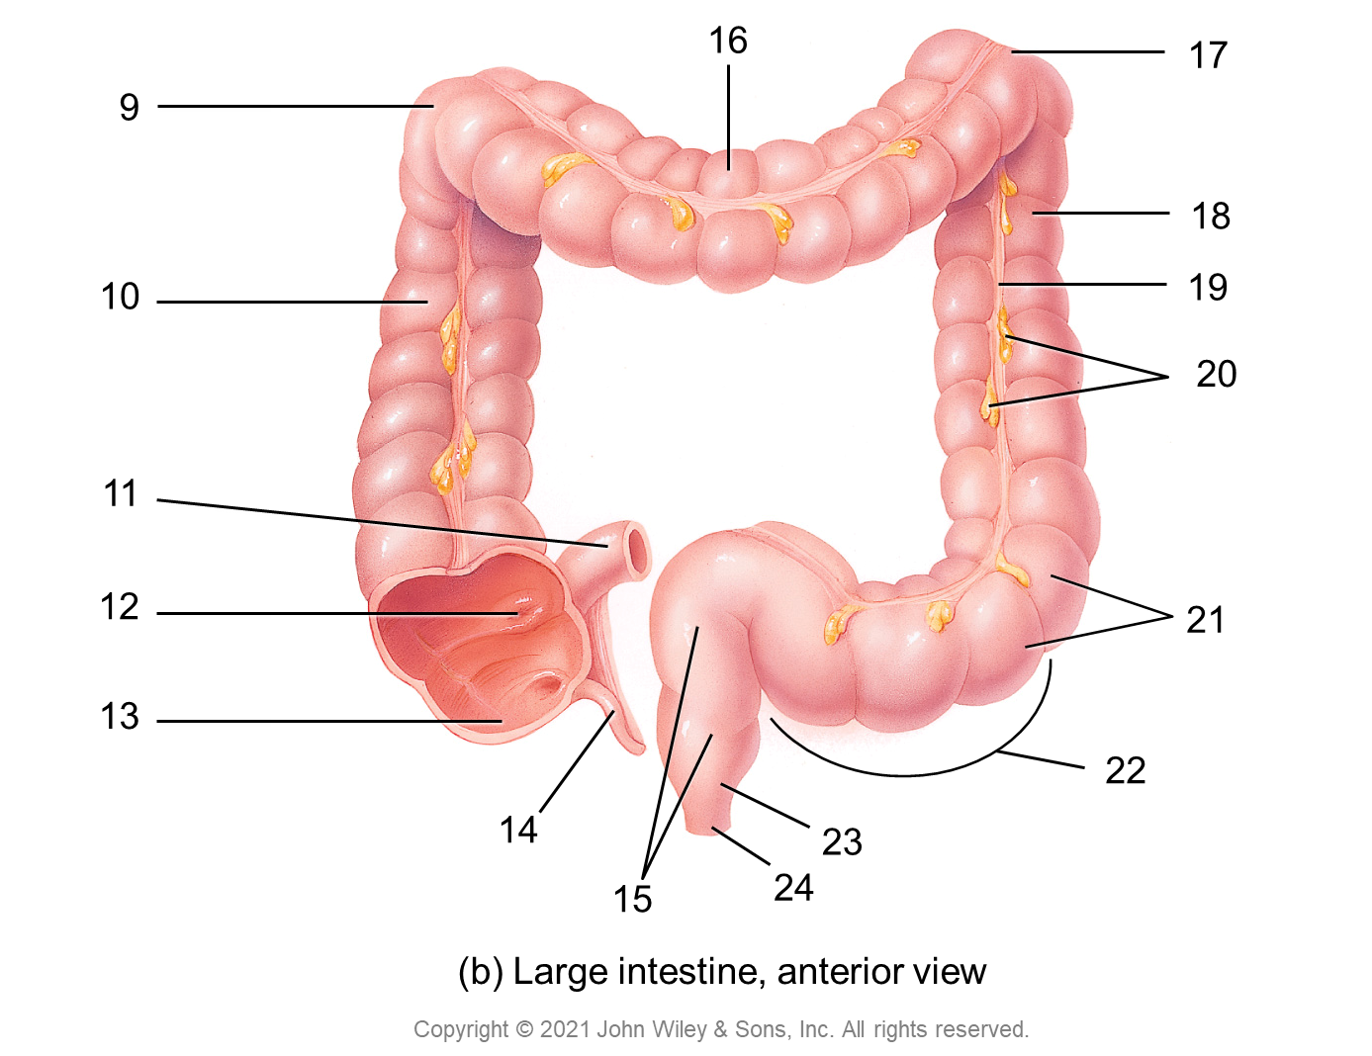
16
17
9
18
10
19
20
11
12
21
13
22
14
23
15
24
(b) Large intestine, anterior view
Copyright © 2021 John Wiley & Sons, Inc. All rights reserved.

